Slide 1



ANALYZING TRUCKING DATA FROM
AZ NATIONALLY
GROUP 10

Slide 2

CONTENTS
Introduction
Contents
Problem Statement & Objective
Data Modelling
Work Flow
Data Visualization Stories
Challenges
Conclusion

Slide 3




PROBLEM STATEMENT
ANT, established a decade ago, comprises 400 staff members, primarily engaged in long-haul trucking services, specializing in general and non-specialized cargo transportation.​ The prevalent occurrence of injuries and fatalities arising from accidents involving large trucks in the United States highlights the importance of ensuring compliance with the corporation's regulations by all drivers in the fleet. ​ This imperative aims to mitigate insurance risks associated with various factors, thereby posing a considerable challenge for fleet managers.​
OBJECTIVES
Identify nationwide dangerous commercial truck drivers.
Focus on drivers with a higher mileage/risk factor
Implement safety measures to reduce accidents caused by high-risk driver

Slide 4






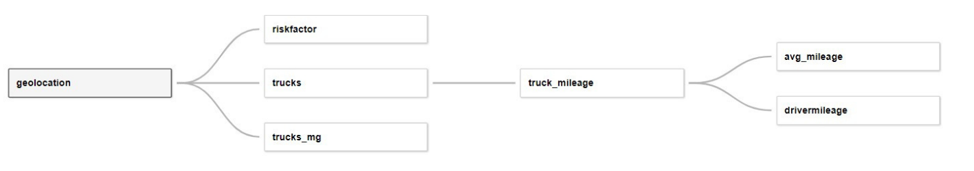
DATA LINEAGE
DATA WORKFLOW
Getting CSV files & storing locally
Transferring files to VMware.
Transforming local directory files to HDFS
Importing data
Importing tables into Tableau using ODBC driver

Slide 5
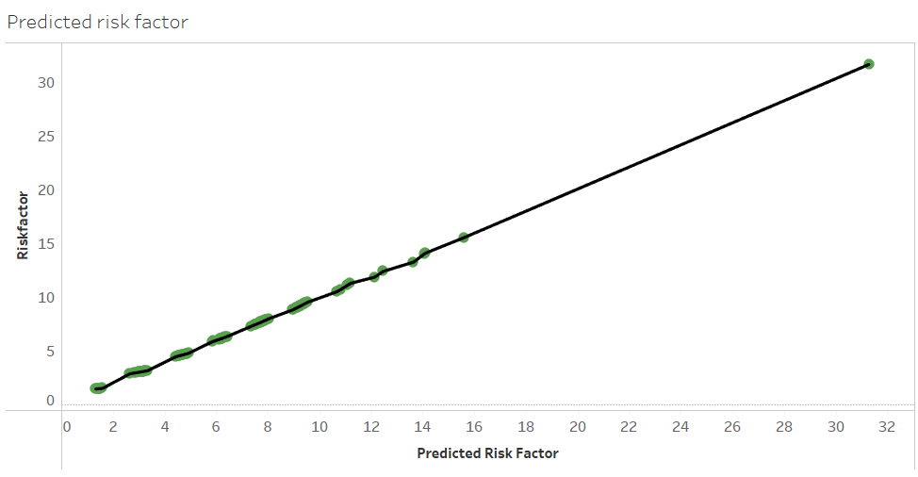
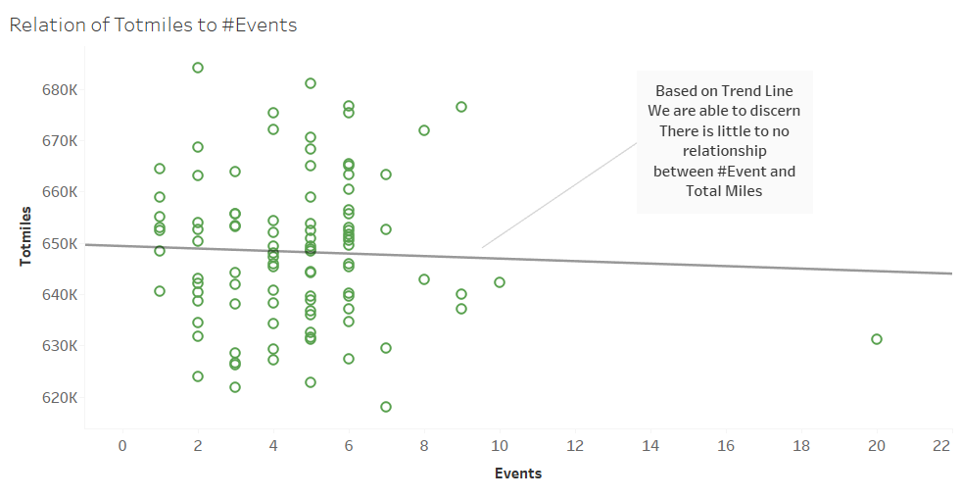
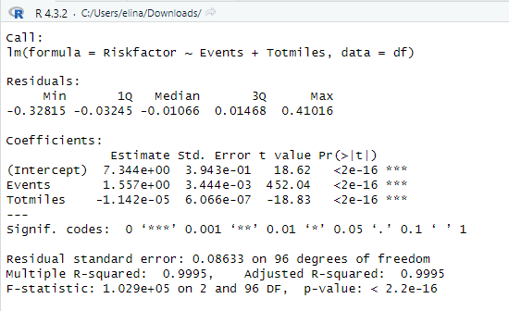
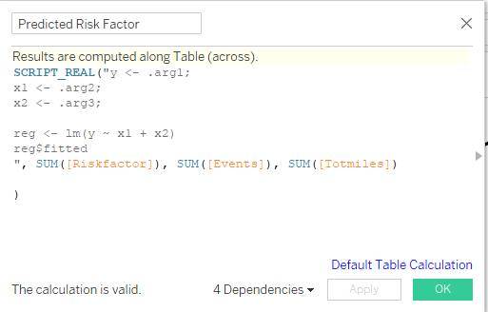
LINEAR REGRESSION

Slide 6
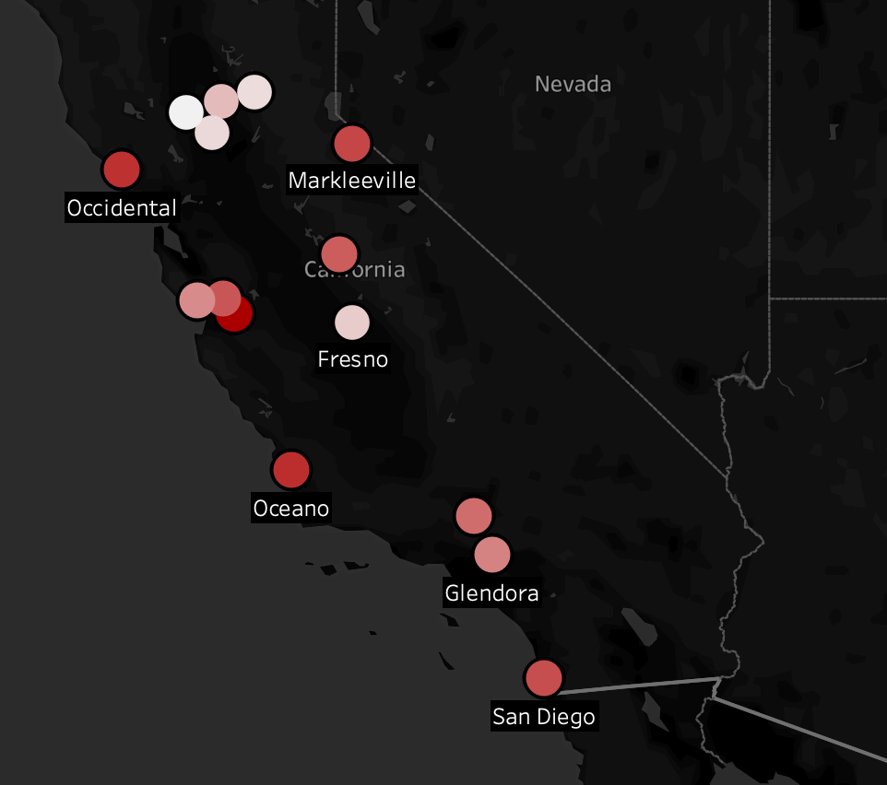
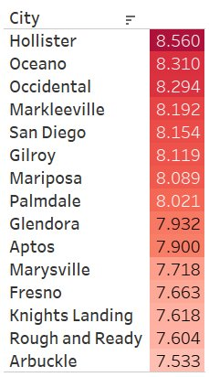
HOW DOES THE SEVERITY OF RISKY DRIVING BEHAVIORS VARY AMONG DIFFERENT CITIES?
- Image shows top 15 cities by average risk factor for driving events.​
- Helps understand high-risk event distribution.​
- Analyze correlation between event frequency and risk scores.​
- Provides insights into overall risk levels in cities.​
- Enhances decision-making for risk mitigation strategies.

Slide 7

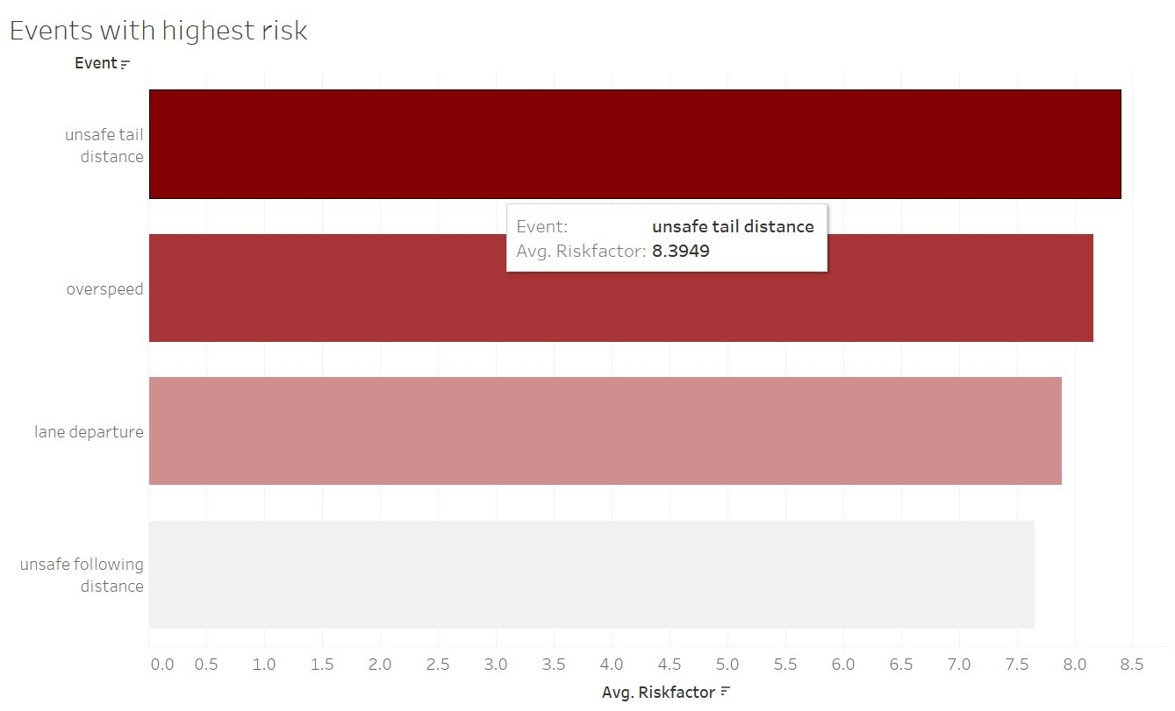
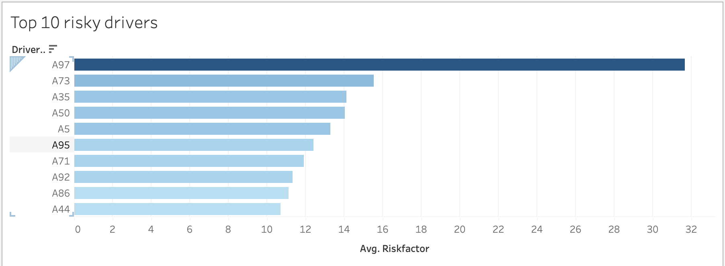
WHO ARE THE TOP 10 RISKY DRIVERS, AND WHAT SPECIFIC BEHAVIORS CONTRIBUTE TO THE HIGHEST RISK FOR THE RISKIEST DRIVER?
The chart lists the top 10 drivers with high risk factors, ranging from highest to lowest.
The driver with the identifier A97 has the highest risk factor, significantly higher than the others.
The risk factors range from above 30 for the highest to below 10 for the lowest.
Recommendations:
Focus on additional training for A97, who has the highest risk.
Review and reinforce safety protocols with all listed drivers.
Monitor these drivers more closely to track improvements.

Slide 8
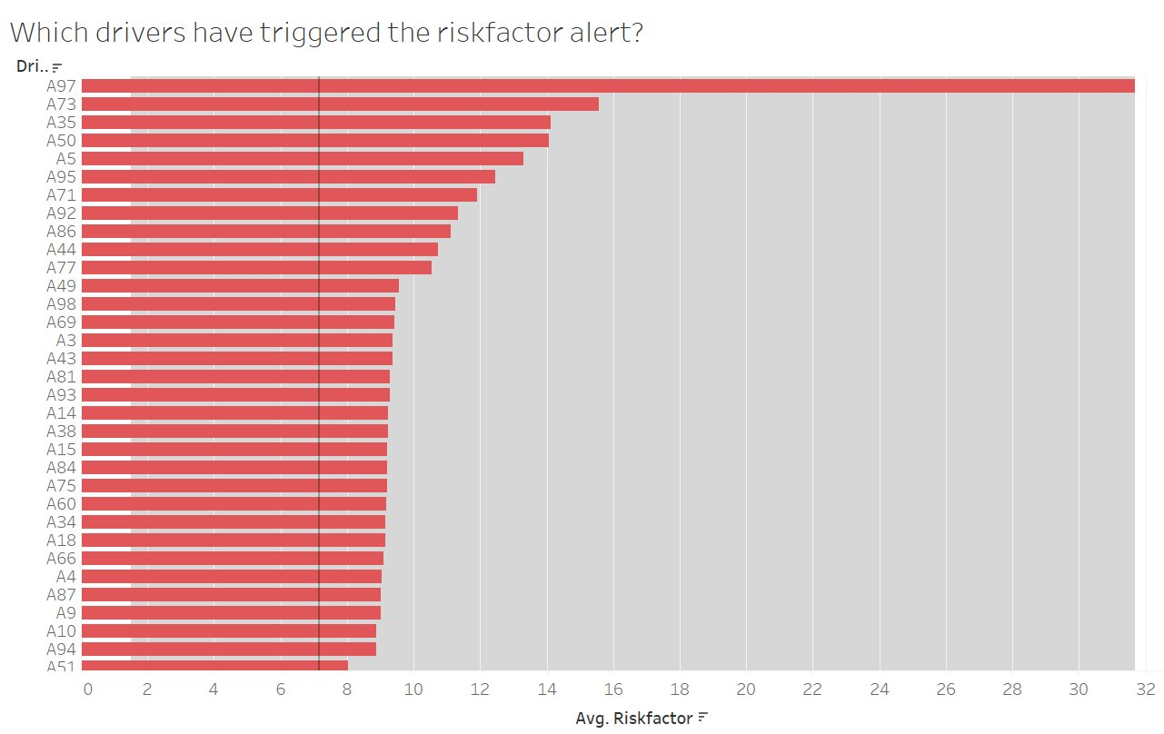

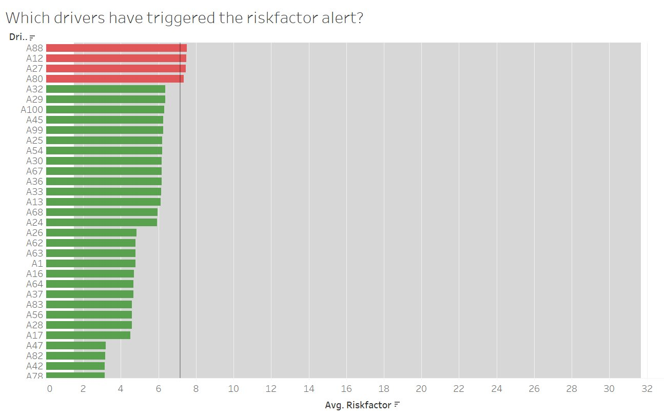
CAN ANT IDENTIFY HIGH-RISK DRIVERS BASED ON THEIR PERFORMANCE METRICS?
Bar chart shows average risk scores for drivers (A41, A85, A70, etc.).
Red indicates risk alerts triggered, green for no alerts.
Helps identify high-risk drivers for corrective actions.
Allows adjustments for improved safety and compliance.

Slide 9

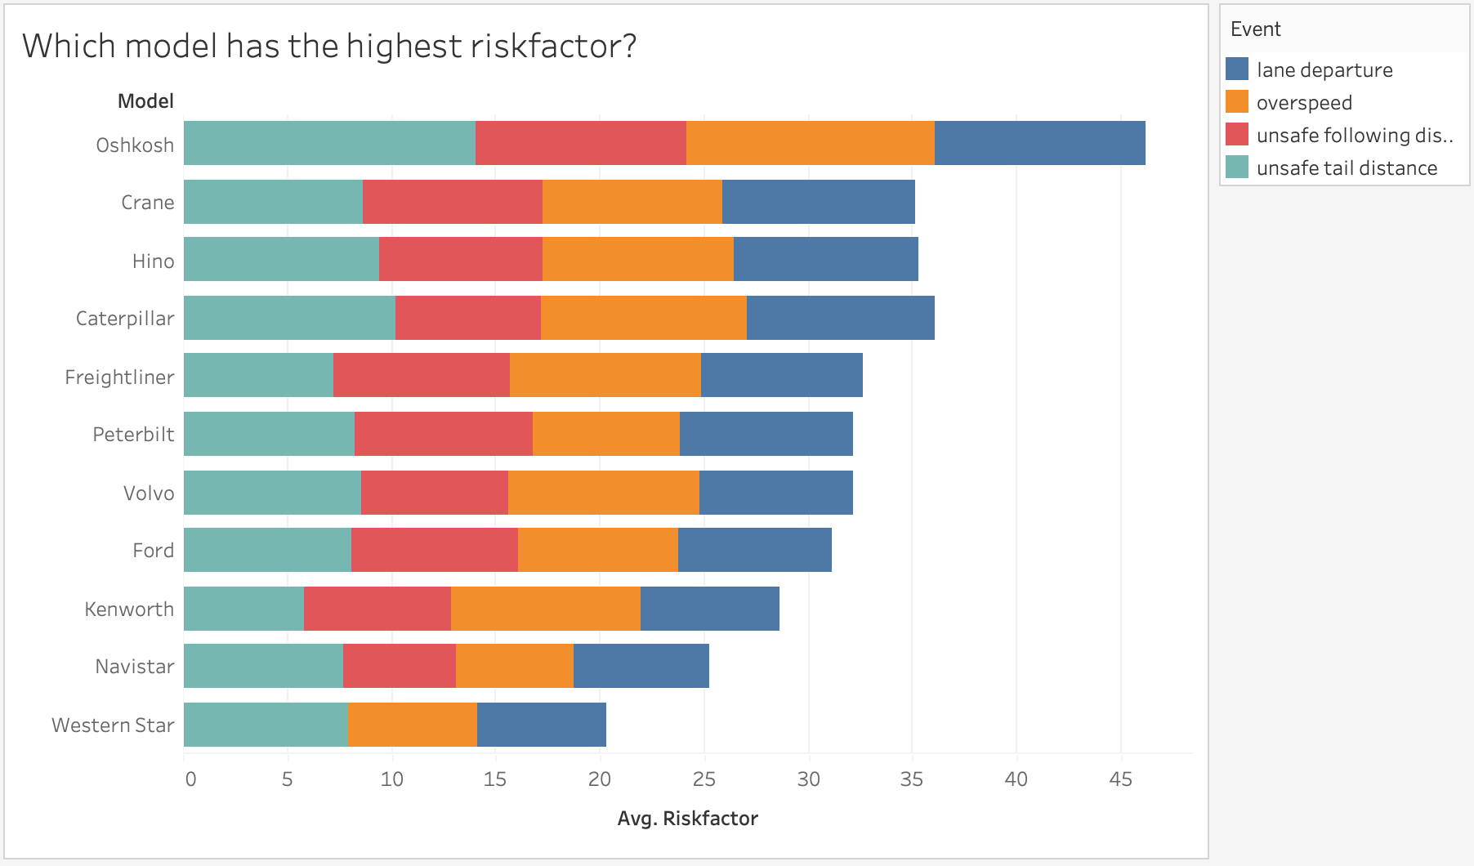
DOES THE RISK FACTOR INCREASE BASED ON THE TRUCK MODEL?
It shows different vehicle models along the y-axis, with the corresponding average risk factor displayed along the x-axis.
The risk factors are broken down into four event categories: lane departure, overspeed, unsafe following distance, and unsafe tail distance.
Oshkosh has the highest average risk factor, with significant contributions from lane departure and overspeed events.
Western Star has the lowest average risk factor among the listed models, with a more balanced distribution of event types.
The bar segments' colors correspond to different driving events, indicating which types of events are most prevalent for each vehicle model.

Slide 10
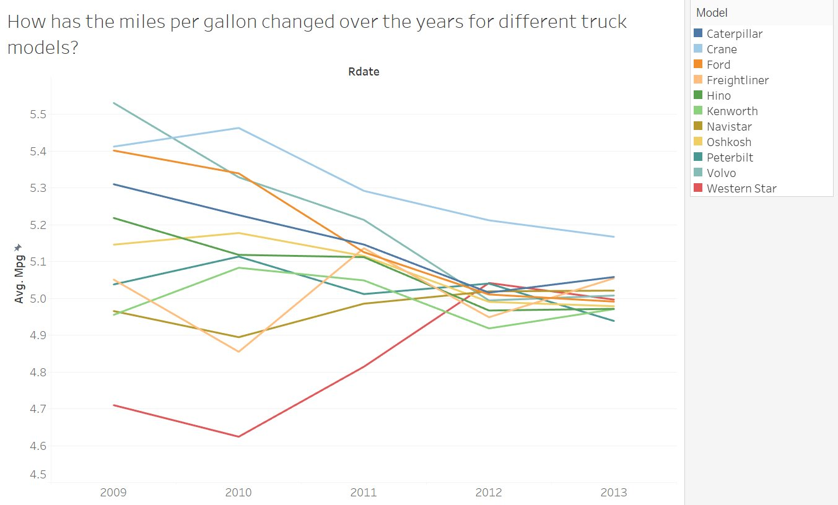
HOW HAS THE MILES PER GALLON CHANGED OVER THE YEARS FOR DIFFERENT TRUCK MODELS?
The graph shows fuel efficiency changes for trucks from 2009 to 2013.
Each truck model's fuel efficiency went up and down over the years.
One truck model's fuel efficiency dropped significantly after 2011.
Another model improved a lot in fuel efficiency between 2010 and 2011.
By 2013, most truck models had similar fuel efficiency.

Slide 11
CHALLENGES
Tableau Features
Debugging
Teammates explored various features and needed to learn new tools.
Frequent meetings and training sessions were necessary.
Sought out online resources for tips and tricks.
Frequently lost connection to VMware while working on Tableau.
Time-intensive error resolution processes indicate a need for improved debugging skills or tools.
Establishing a robust system for logging and tracking bugs to streamline debugging and prevent recurrence.

Slide 12

CONCLUSION & RECOMMENDATIONS
Conclusions:
The outlier A97 represents a significant deviation from the norm and may indicate an underlying issue such as measurement error, exceptional driving conditions, or an area for further safety training.
Driver A73's consistently high risk factor, even when controlling for outliers, suggests that individual driver behavior may contribute more significantly to risk than previously understood.
The observed patterns in driving behaviors across various drivers and vehicle models suggest systemic risks that are not isolated to individual cases but may be indicative of broader trends in driving practices or vehicle performance.
The varying risk factors among different vehicle models imply that there may be inherent differences in how vehicle types influence driver behavior, possibly due to ergonomic design, vehicle handling characteristics, or driver-vehicle interaction dynamics.
Recommendations:
Apply regression analysis in the future to figure out if the number of miles drivers cover or their average speed has a bigger impact on the likelihood of incidents. This will help pinpoint what to focus on to reduce risks.
Get more details about the drivers, like their driving history and habits. More information will lead to a clearer picture of what causes risky situations and how to prevent them.
Set up programs that specifically teach drivers how to avoid the most common dangers, like speeding or not keeping enough distance. Use the actual data on past incidents to make these programs really effective.
Do a thorough safety check on each model of vehicle to see if certain features are making driving riskier. Once you know what they are, you can either fix the problem or give drivers special training to deal with it safely.

Slide 13


QUESTIONS?
Thank you!

